Slide 1
Arrays

Slide 2
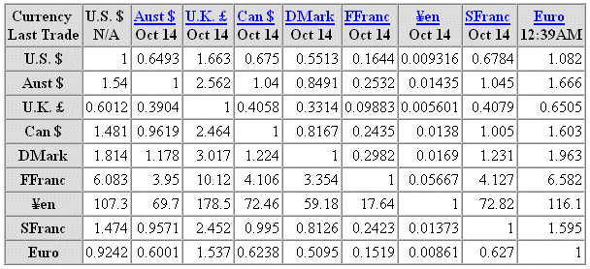
Arrays
An array is a collection of data elements that are of the same type (e.g., a collection of integers, collection of characters, collection of doubles).

Slide 3

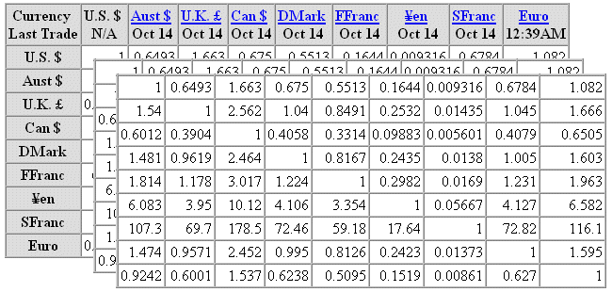
Arrays
1-dimensional array.
3-dimensional array (3rd dimension is the day).
Oct 14
Oct 15
Oct 16

Slide 4
Array Applications
Given a list of test scores, determine the maximum and minimum scores.
Read in a list of student names and rearrange them in alphabetical order (sorting).
Given the height measurements of students in a class, output the names of those students who are taller than average.

Slide 5
Array Declaration
Syntax:
<type> <arrayName>[<array_size>]
Ex. int Ar[10];
The array elements are all values of the type <type>.
The size of the array is indicated by <array_size>, the number of elements in the array.
<array_size> must be an int constant or a constant expression. Note that an array can have multiple dimensions.

Slide 6
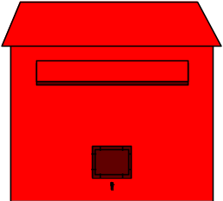
Array Declaration
  // array of 10 uninitialized ints
  int Ar[10];
0
1
2
3
4
5
6
7
8
9
Ar
--
--
--
--
--
--
--
--
--
--
0
1
2
3
4
5

Slide 7
Subscripting
Declare an array of 10 integers:
  int Ar[10]; // array of 10 ints
To access an individual element we must apply a subscript to array named Ar.
  A subscript is a bracketed expression.
    The expression in the brackets is known as the index.
  First element of array has index 0.
    Ar[0]
  Second element of array has index 1, and so on.
    Ar[1], Ar[2], Ar[3],…
  Last element has an index one less than the size of the array.
    Ar[9]
Incorrect indexing is a common error.

Slide 8
Subscripting
  // array of 10 uninitialized ints
  int Ar[10];
  Ar[3] = 1;
  int x = Ar[3];
0
1
2
3
4
5
6
7
8
9
Ar
--
--
--
1
--
--
--
--
--
--
Ar[0]
Ar[1]
Ar[2]
Ar[3]
Ar[4]
Ar[5]
Ar[6]
Ar[7]
Ar[8]
Ar[9]

Slide 9
Subscripting Example 1
  //For loop to fill & print a 10-int array
#include <iostream.h>
  int main ( ) {
  int index, ar[10]; // array for 10 integers
  // Read in 10 elements.
  cout << "Enter 10 integers: ";
  for(index = 0; index < 10; index ++)
  cin >> ar[index];
  cout << endl;
  cout << "The integers are ";
  for(index = 0; index < 10; index ++)
  cout << ar[index] << " ";
  cout << endl;
  return 0;
  }

Slide 10
Sorting with Arrays: Ex. 2
// Compare and sort three integers
void swap (int&, int&);
int main ( ) {
int ar[3]; // input integers
// Read in three elements.
cout << "Enter three integers: ";
cin >> ar[0] >> ar[1] >> ar[2];
if (ar[0] > ar[1]) swap (ar[0], ar[1]);
if (ar[1] > ar[2]) swap (ar[1], ar[2]);
if (ar[0] > ar[1]) swap (ar[0], ar[1]);
cout << "The sorted integers are " << ar[0]
<<", " << ar[1] << ", " << ar[2]
<< endl;
return 0;
}

Slide 11
Swapping Function: Ex. 2
// Function for swapping two integers
void swap (int& first, int& second) {
int temp;
temp = first;
first = second;
second = temp;
}

Slide 12
Array Element Manipulation Ex. 3
Consider
  int Ar[10], i = 7, j = 2, k = 4;
  Ar[0] = 1;
  Ar[i] = 5;
  Ar[j] = Ar[i] + 3;
  Ar[j+1] = Ar[i] + Ar[0];
  Ar[Ar[j]] = 12;
  cin >> Ar[k]; // where the next input value is 3
0
1
2
3
4
5
6
7
8
9
Ar
1
--
8
6
3
--
--
5
12
--
Ar[0]
Ar[1]
Ar[2]
Ar[3]
Ar[4]
Ar[5]
Ar[6]
Ar[7]
Ar[8]
Ar[9]

Slide 13
Array Initialization Ex. 4
  int Ar[10] = {9, 8, 7, 6, 5, 4, 3, 2, 1, 0};
  Ar[3] = -1;
0
1
2
3
4
5
6
7
8
9
Ar
9
8
7
6
5
4
3
2
1
0
0
1
2
3
4
5
6
7
8
9
Ar
9
8
7
-1
5
4
3
2
1
0

Slide 14
Initializing arrays with random values
The following loop initializes the array myList with random values between 0 and 99:
for (int i = 0; i < ARRAY_SIZE; i++)
{
myList[i] = rand() % 100;
}

Slide 15
Program with Arrays
int main()
{
int values[5]= {11,1,3,6,10};
for (int i = 1; i < 5; i++)
{
values[i] = values[i] + values[i-1];
}
values[0] = values[1] + values[4];
}

Slide 16
Printing arrays
To print an array, you have to print each element in the array using a loop like the following:
for (int i = 0; i < ARRAY_SIZE; i++)
{
cout << myList[i] << " ";
}

Slide 17
Copying Arrays
Can you copy array using a syntax like this?
list = myList;
This is not allowed in C++. You have to copy individual elements from one array to the other as follows:
for (int i = 0; i < ARRAY_SIZE; i++)
{
list[i] = myList[i];
}

Slide 18
Summing All Elements
Use a variable named total to store the sum. Initially total is 0. Add each element in the array to total using a loop like this:
double total = 0;
for (int i = 0; i < ARRAY_SIZE; i++)
{
total += myList[i];
}

Slide 19
Finding the Largest Element
Use a variable named max to store the largest element. Initially max is myList[0]. To find the largest element in the array myList, compare each element in myList with max, update max if the element is greater than max.
double max = myList[0];
for (int i = 1; i < ARRAY_SIZE; i++)
{
if (myList[i] > max) max = myList[i];
}

Slide 20
Finding the smallest index of the largest element
double max = myList[0];
int indexOfMax = 0;
for (int i = 1; i < ARRAY_SIZE; i++)
{
if (myList[i] > max)
{
max = myList[i];
indexOfMax = i;
}
}

Slide 21
Shifting Elements
double temp = myList[0]; // Retain the first element
// Shift elements left
for (int i = 1; i < myList.length; i++)
{
myList[i - 1] = myList[i];
}
// Move the first element to fill in the last position
myList[myList.length - 1] = temp;

Slide 22
#include <iostream> // Random Shuffling
#include <cstdlib>
#include <ctime>
using namespace std;
const int ARRAY_SIZE = 10;
int main(){
int myList[ARRAY_SIZE]= {1,2,3,4,5,6,7,8,9,10};
srand(time(0));
for ( int i = 0; i < ARRAY_SIZE; i++)
{ // Generate an index randomly
int index = rand() % ARRAY_SIZE;
int temp = myList[i];
myList[i] = myList[index];
myList[index] = temp;
}
for ( int i = 0; i < ARRAY_SIZE; i++)
cout << myList[i] <<' ';
cout << endl;
return 0;}

Slide 23
#include <iostream> // Create 6 random numbers for Mark 6
#include <cstdlib>
#include <ctime>
using namespace std;
const int ARRAY_SIZE = 6;
int main(){
int used[50] ={0}; //indicate if a random number is used.
int Mark[6], temp;
srand(time(0));
int i = 0;
while (i < 6){
temp = rand()%49 + 1;
if (used[temp] == 0) { //temp is not used
Mark[i] = temp; i++;
used[temp] = 1;
}
for ( int i = 0; i< 6; i++)
cout << Mark[i] << endl;
return 0;
}

Slide 24
#include <iostream.h> //Print numbers in reversed order
#include <cstdlib.h>
#include <ctime.h>
#include <iomanip.h>
int main(){
srand(time(0));
int numbers[500];
int num_num;
cout<< "How many numbers (up to 500)?";
cin >> num_num;
for ( int i= 0; i < num_num; i++)
numbers[i] = rand()%100;
cout << "\n Your numbers reversed are:\n";
for ( int j= num_num-1 ; j >= 0; j--)
cout << setw(3) << numbers[j];
cout << endl;
return 0;}

Slide 25
#include <iostream.h> //print histogram
#include <fstream.h>
#include <iomanip.h>
int main(){
ifstream ins;
int count[26]={0};
char next;
ifstream input_stream;
char input_file_name[16]; // declare the input file names
cout << "Enter the input file name (max 15 characters):\n";
cin >> input_file_name;
ins.open(input_file_name); // open the file
ins >> next; // get the first char
while(!ins.eof()){ // loop to read each line
next = tolower(next);
if (isalpha(next))
count[ next - 'a']++;
ins >> next; }
ins.close();
for (char i = 'a'; i <='z'; i++) // print_histogram(count);
cout << i << ": " << count[i-'a'] << endl;
return 0;
}

Slide 26
void print_histogram( int list[]){
int max = list[0];
for (int i = 1; i < 26; i++){
if (max < list[i])
max = list[i];
}
double ratio= 70.0 /max ;
for ( i = 0; i < 26; i++){
cout << char ('a'+i) <<": “
<< setw(5) <<list[i] <<‘ ‘;
int count = list[i]* ratio;
for ( int j = 0; j < count; j++)
cout <<'*';
cout << endl;
}
cout << endl;
}

